Slide 1
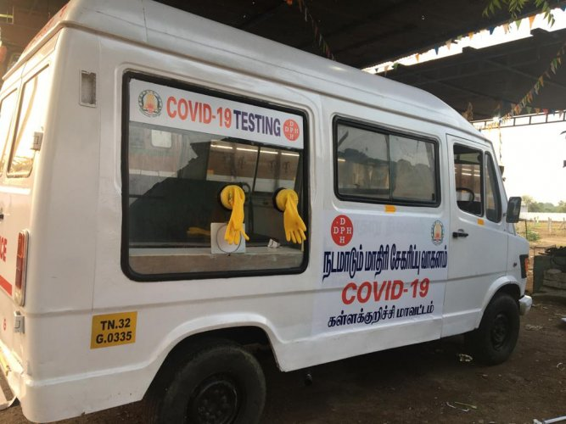

Mobile vans to test for COVID-19 Infection
CodeBlooded:
Akansha Agarwal
Aman Kapoor
Ankit Yadav
Alajangi Niharika
Aman Kumar

Slide 2
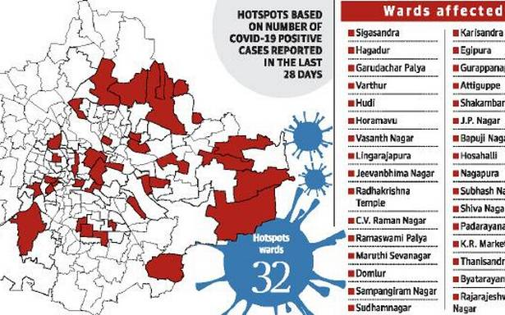
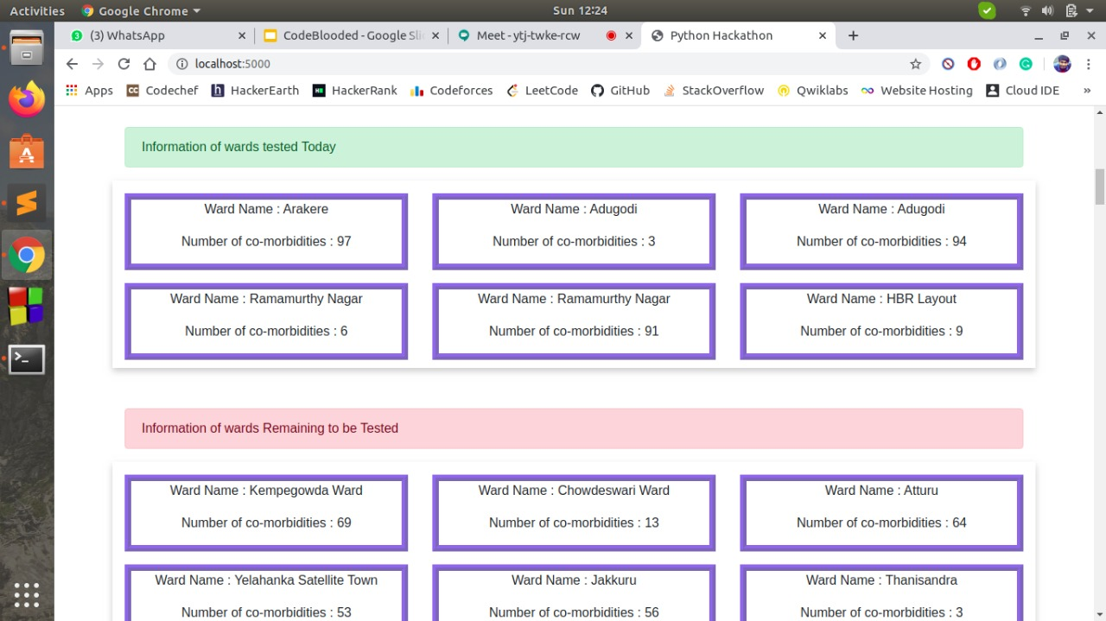
Receiving input on wards in Bangalore
DISPLAY OF THE COLLECTED INPUT
ON THE WEBSITE CREATED BY US:
BANGALORE WARDS MAP
The VANS find an alternative path to reach the wards and do not pass the containment zones.
WE INTEND TO DO THIS BY:1)Visting those wards with higher co-morbidities.
2)Then visit wards with higher probable cases avoiding the hot spots by marking them.

Slide 3
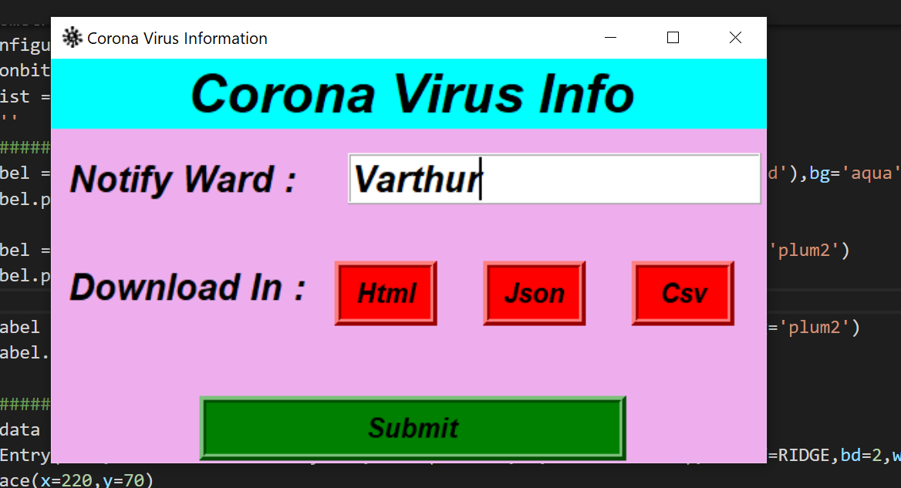
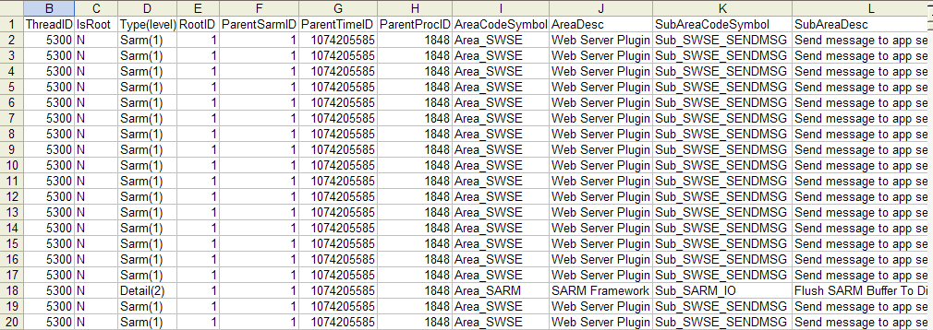
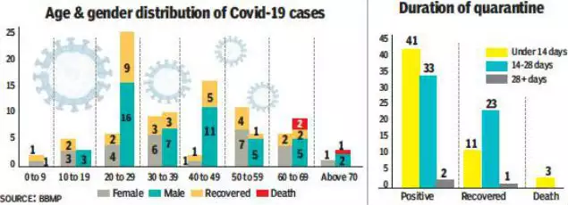
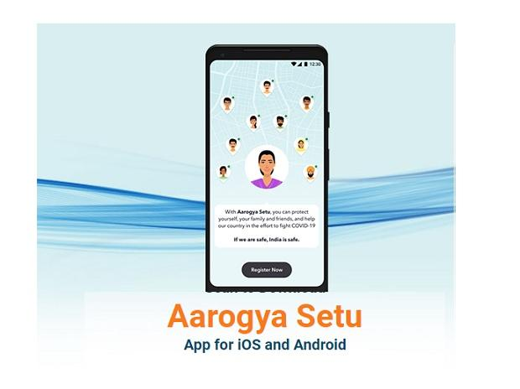
Interface to receive inputs from Aarogya-Sethu App
BEFORE:
AFTER:
We created a GUI using which we scrap data from website and it also serves as a coronavirus notifier.We can download the data in html,json or csv format from website.
We prioritize data based on co-morbidities and the zones with higher priority are visited first.

Slide 4








HOW WE INTEND TO CARRY OUT THE TESTING??
Higher
Co-morbidities wards
Normal wards
Containment wards
LABEL
Notes:
1)They visit the wards with higher co-morbidities and then the normal wards ignoring red wards.

Slide 5
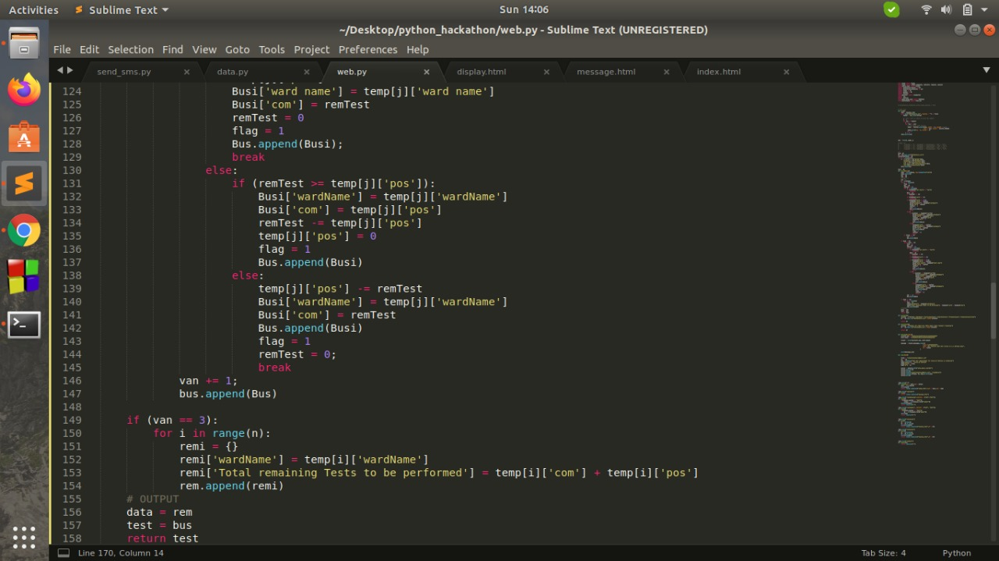
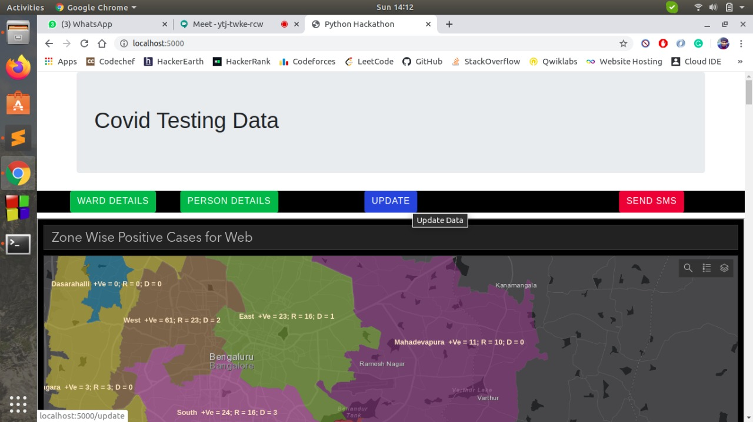
ALGORITHM - IMPLEMENTED USING LIST OF DICTIONARIES :
USING THE UPDATE BUTTON WE GET THE UPDATED TESTING DETAILS FOR EACH DAY
Notes:
???

Slide 6
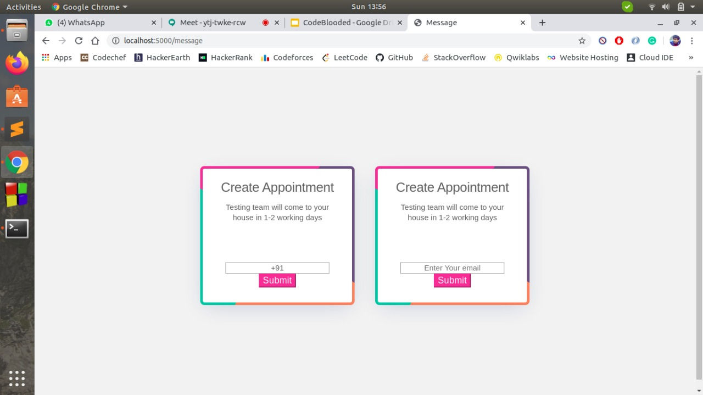
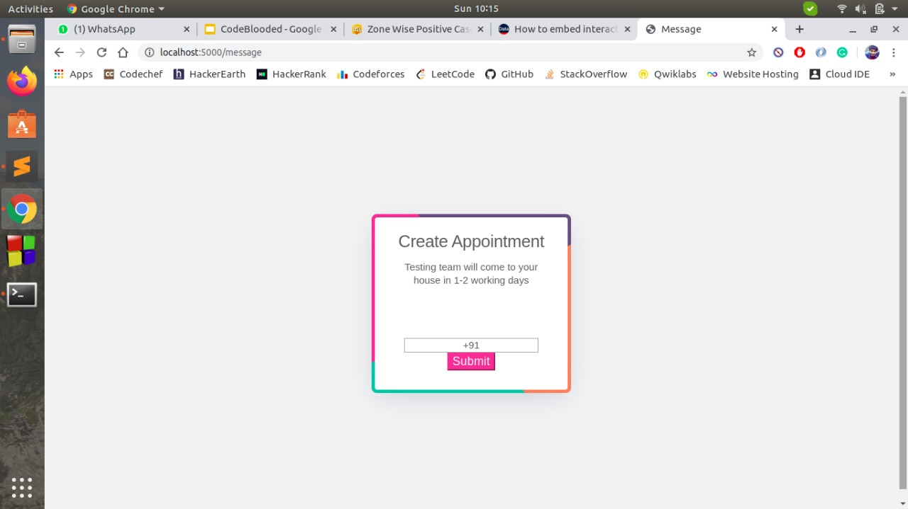
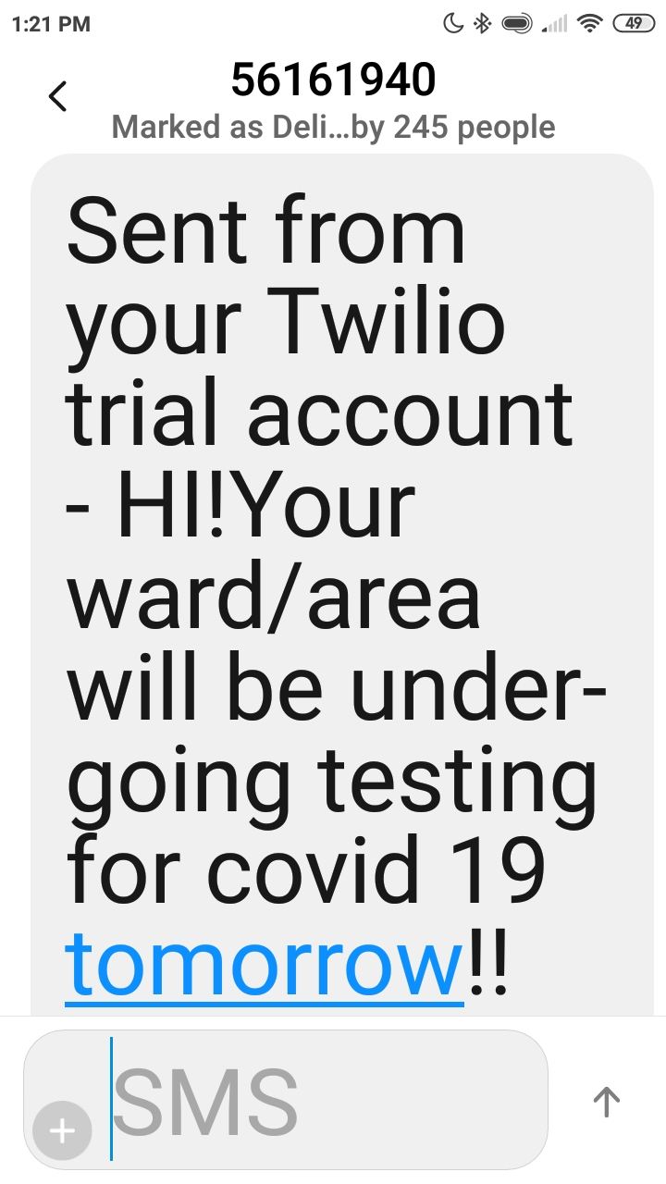
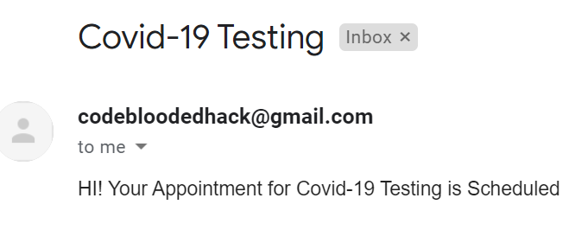
MESSAGES ON APPOINTMENTS
SMS
MAIL
We use the Twilio API to send SMS using Python.This can be done since Python is a scripting language.We need to create an account in Twilio for this.
We can send MAIL using python by importing “smtplib”.For GMAIL we use the port no. 587.

Slide 7
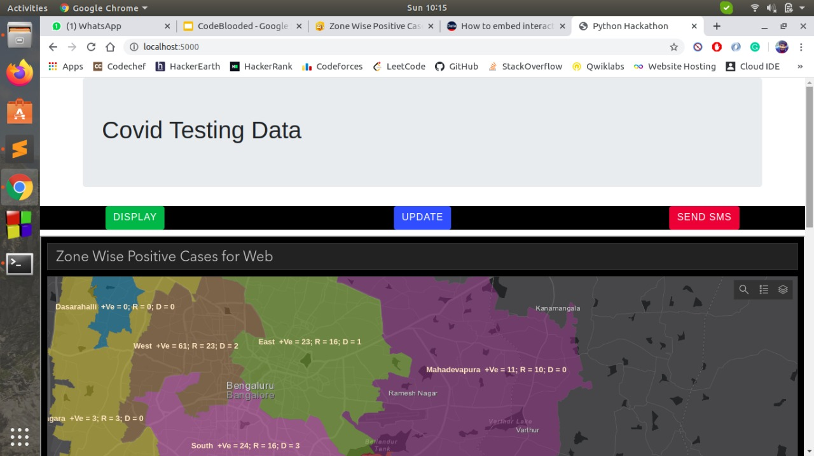
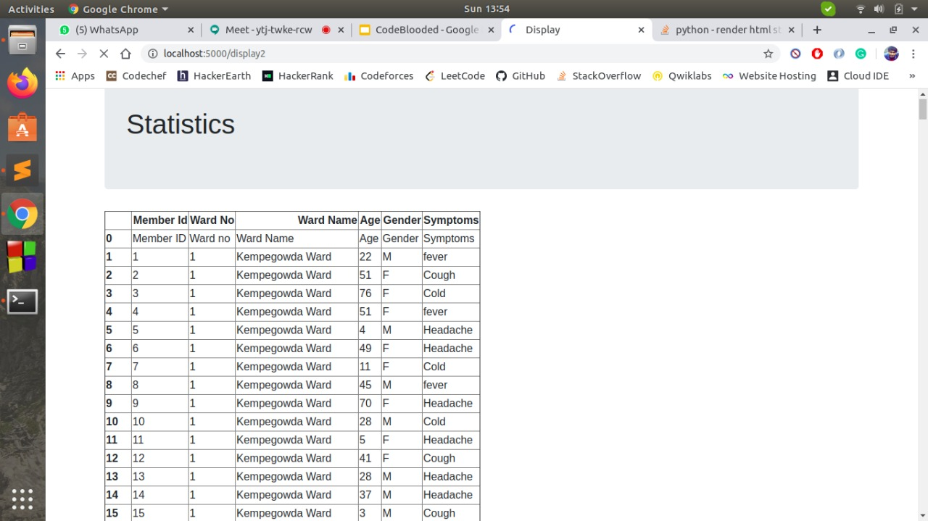
DASHBOARD FOR WARD WISE STATUS
Zone wise positive cases map is displayed on website. Also our website contains buttons using which we can send sms and mail.
Statistics regarding person details and ward details has also been included on our website.
Displaying on our website the status of each ward, the wards tested and the wards remaining to be tested.

